Slide 1
Business letters

Slide 2
Things to discuss
What are business letters
Why business letters
Types of business letters
Formats/styles of business letters

Slide 3
Fruit for thought.
How does a business letter differ from:
A letter to a friend?
An email to the same business associate?
A fax of same document?

Slide 4
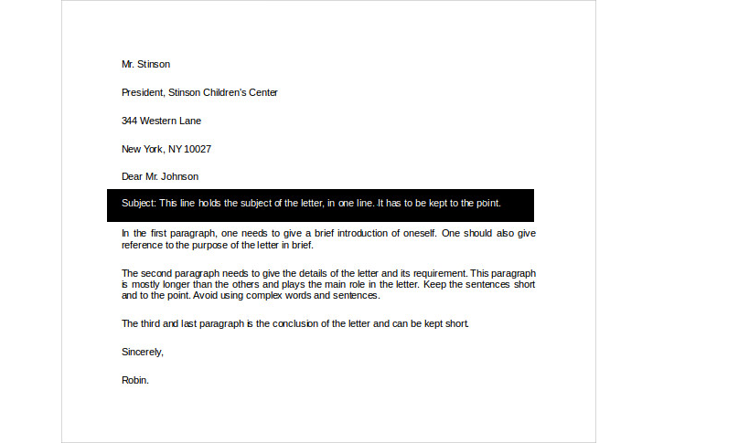
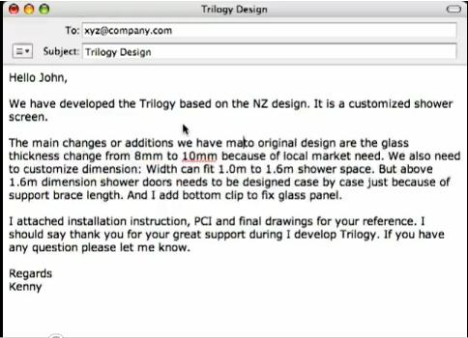
LETTER WITH SUBJECT LINE
EMAIL

Slide 5
What are business letters
A business letter is a letter written in formal language usually Written by one business organization to another, or for correspondence between organizations and their customers, clients and other external parties.

Slide 6
Why business letters?
Business letters assist you in sustaining your business relationships with the external world i.e. organizations, customers and government departments.
It serves as a record for future reference.
It is used to build goodwill.

Slide 7
Principles of writing business letters:
Determine your purpose
Write a plan
Develop a catchy but meaningful subject line.
Draft and redraft
Edit and proofread (for grammar, meaning and style.

Slide 8
Kinds of business letters:
1. Formal Business Letter – Letters meant for legal or official correspondence. These include letters regarding business deals, order, claim, dispute settlement, agreements, adjustments, information request, sales report and other official matters.
2. Informal Business Letter – It is used for casual correspondence but doesn’t necessarily has to have a casual tone of language. These letters include memorandums, appraisals, interview thanks, reference letters, cover letter, customer complaint letters, e-mails and others which are less important or regular.

Slide 9
TYPES OF BUSINESS MESSAGES based in accordance with the effect it has on the reader
FOUR TYPES
 POSITIVE Messages Convey good feeling Letters of appreciation, thanks giving, expression of interest, sympathy, etc.
 NEGATIVE Messages Convey disappointment, disapproval, dissatisfaction Letters of disapproval, disagreement, denial, refusal, job denials, cancellation, etc.
 NEUTRAL Messages Convey no feeling, contain information, necessitating action Day-to-day messages, reports, routine letters, reminders, proposals, etc.
 PERSUASIVE Messages Action demanding communication system, agreement with the writer’s point of view Memoranda of Interests, Invitations, Brochures, etc.

Slide 10
Depending upon the client, content, motive and other factors, Letters of Business can be further subdivided into:
Cover letter
Thank you letter
Letter of resignation
Reference letter
Letter of recommendation
Letter of interest
Inquiry letter
Letter of intent
Sales letter
Complaint letter
Adjustment letter
Order letter
Acknowledgment letter
Resume Cover Letter

Slide 11
Approaches of letter writing
There are basically 3 approaches
Direct (ex: appointment letter, routine messages, etc)
Indirect (ex: denial/refusal, bad news, etc)
Persuasive (A.I.D.A- ex: marketing, requesting, funding, etc)

Slide 12
Standard components
The letterhead-(Topmost heading with name, address & logo)
The date-(Exactly below the letterhead, D.M.Y)
Recepient-(Name, Designation and Full address, NUMBER & email)
Salutation-(word of greeting, courteous gesture, Dear Sir / Madam etc.)
Subject line-(briefly, purposefully, and attractively written purpose of letter, sometimes centre justified)

Slide 13
Subject line
Use a verb phrase to briefly summarise the content of the email message.
Too wordy: ‘We will have our monthly meeting on Wednesday to discuss the new occupational, health and safety policy.’
Too brief: ‘Meeting’.
Appropriate: ‘Meeting on Wednesday to discuss H&S policy’.

Slide 14
Standard components
5. Body of the letter: (Main message, 3-4 paragraphs, mention in first line if there is any previous reference. Last paragraph sums up and calls for action)
6. Sign off: (A respect mark i.e. Yours Sincerely or Sincerely etc.)
7. Personal signature: (name and title of sender)
8. Enclosure: attachments, few lines after the Signature, provide the number and type of documents attached e.g. ‘Enclosures (2): brochure, resume’.

Slide 15
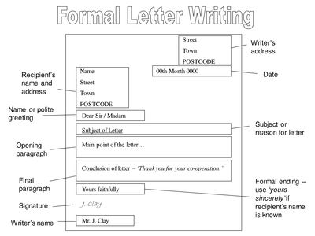
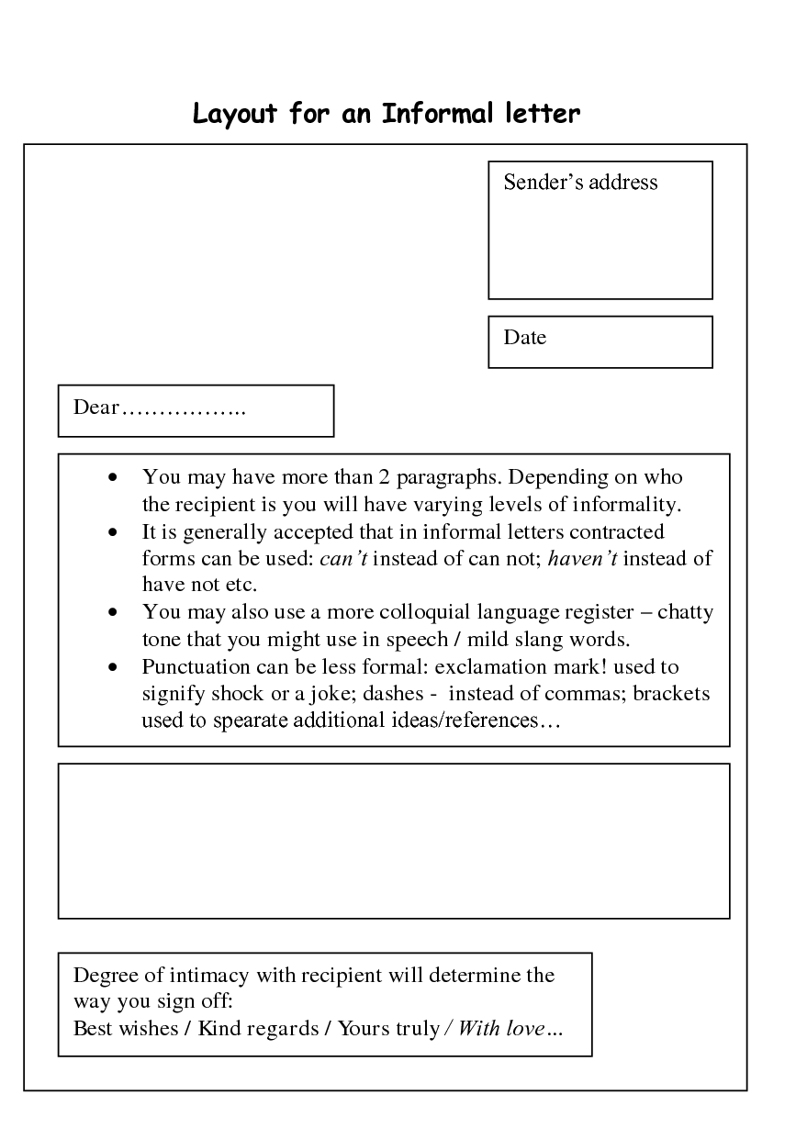
FORMAL VS INFORMAL LETTERS

Slide 16
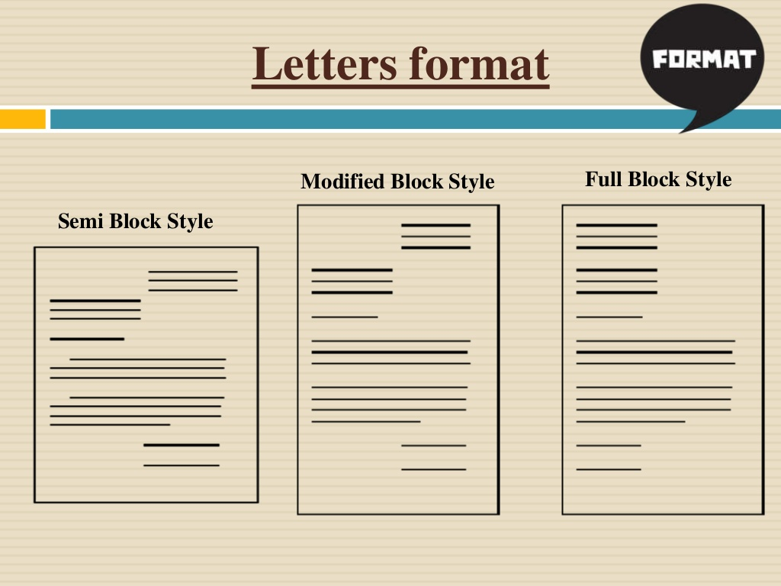

Slide 17
Business Letter Styles/Drafts
There are four styles or drafts used:
Full Block Style –
Semi-Block/simplified Style –
Modified Block Style –
Modified Semi-Block Style –

Slide 18
1.Blocked format.
Its mainly used and the main purposes are to inform, request or register a complaint.
All the text/elements are aligned to the left margin.
Paragraphs are not indented, separated by double spacing While within each part and paragraph single spacing is preferred.
There is no punctuation in the addresses
There is a comma after the greeting, although some in the U.S. prefer a colon
The closing is also followed by a comma

Slide 19
23 North Main Street
ABC Colony
Post Box no. 253447
kARACHI-4004800
February 23, 2010
Dr. ABC
Customer Relations
ABC Company
154 Petal Street
Karachi-4004800
Subj: BALANCE PAYMENT ALREADY MADE
I-----------------------------------------------------------------------------------------
----------------------------------------------------------------------------------------
----------------------------------------------------------------------------------------
Sincerely,
XYZ
Encl: copy of cancelled cheque
Sender`s details
Receiver's details
Subj
Opening
Body
closing
Complementary close

Slide 20
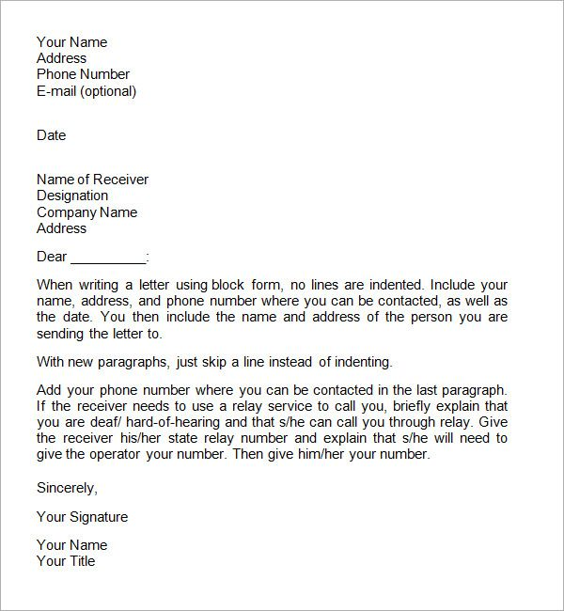
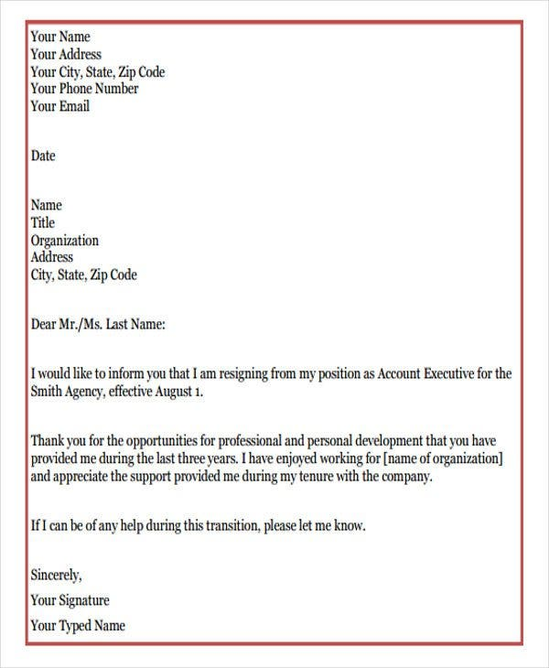

Slide 21
2. Semi-Block/ simplified Style–
It has partial formatting of a full block style.
In Semi-Block Format Letter:
All text is aligned to the left margin
Paragraphs are indented
Omits salutation
Often includes subject line in capital letters
Omits complimentary close

Slide 22
Semi-Block/ simplified Style, sample–
23 North Main Street
ABC Colony
Post Box no. 253447
kARACHI-4004800
February 23, 2010
Dr. ABC
Customer Relations
ABC Company
154 Petal Street
Karachi-4004800
Subj: BALANCE PAYMENT ALREADY MADE
I-----------------------------------------------------------------------------------------
----------------------------------------------------------------------------------------
----------------------------------------------------------------------------------------
ABC
Manager
ABC company
Encl: copy of cancelled checque

Slide 23
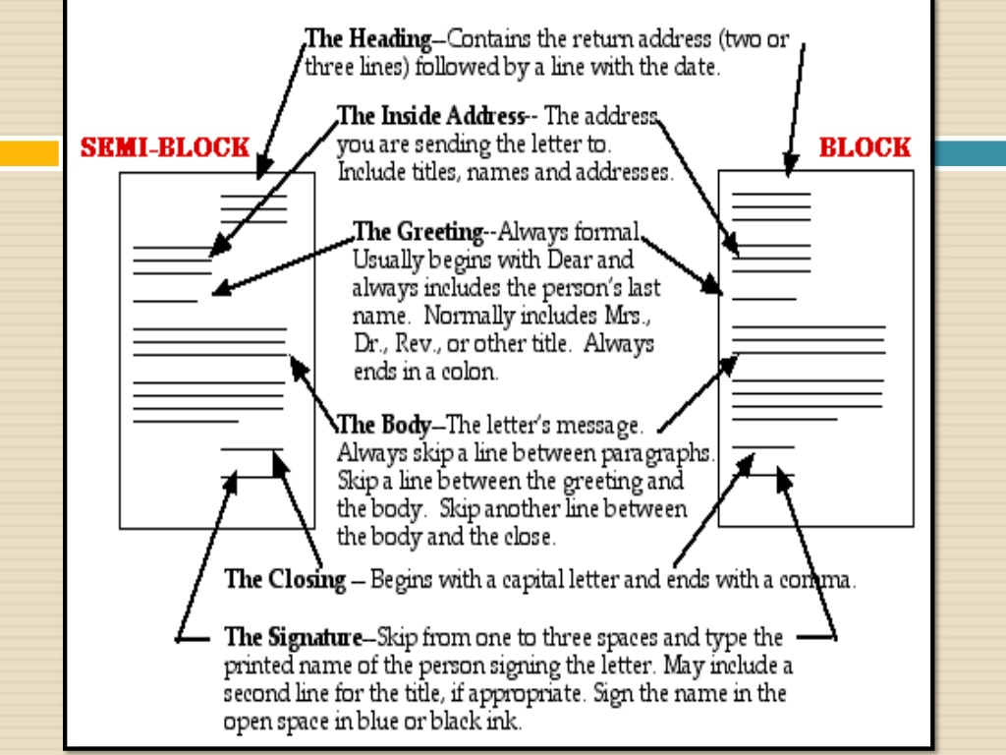

Slide 24
3. Modified Block Style –
It`s the conventional way of writing formal business letters.
Its format is applicable to both print and email correspondence.
Its main purposes include cover letters, thank you letters, letters of resignation and sales letters.
In Modified Block Format Letter:
All text is aligned to the left margin, except for the author's address, date, and closing
Paragraphs are not indented
The author's address, date, and complementary close are usually indented three inches from the left margin or to complete right margin.

Slide 25
23 North Main Street
ABC Colony
Post Box no. 253447
Karachi-4004800
February 23, 2010
Dr. ABC
Customer Relations
ABC Company
154 Petal Street
Karachi-4004800
Subj: BALANCE PAYMENT ALREADY MADE
I-----------------------------------------------------------------------------------------
----------------------------------------------------------------------------------------
----------------------------------------------------------------------------------------
sincerely.
xyz
Encl: copy of cancelled checque

Slide 26
4. Modified Semi-Block Style (olden style)
It`s elements are somehow similar to that of modified block style except that the start of each paragraph is indented.
In Modified Semi-Block Format Letter:
All text is aligned to the left margin, except for the author's address, date, and closing
The author's address, date, and closing are usually indented in same position
Paragraphs are indented

Slide 27
ABC Colony
Post Box no. 253447
Karachi-4004800
February 23, 2010
Dr. ABC
Customer Relations
ABC Company
154 Petal Street
Karachi-4004800
BALANCE PAYMENT ALREADY MADE
I-----------------------------------------------------------------------------------------
----------------------------------------------------------------------------------------
----------------------------------------------------------------------------------------
sincerely.
xyz
Encl: copy of cancelled checque

Slide 28
Expressions to be used in salutation and closing:
SALUTATION
To whom it may concern
Dear Mr./Ms.
Dear Sir or Madam
Respected Sir or Madam
Mr./ Ms./ Dr./ Prof./ Engr.
CLOSING
Best regards,
Sincerely,
Yours faithfully,
Yours truly,
With kind regards,

Slide 29
Expressions to be used in body paragraphs
BODY PARAGRAPH
I am pleased to inform you
I am writing to give you some details regarding…
I hope all is well with you
Thank you for your prompt response
Thank you for your consideration
Thank you for bringing this matter to my attention
In reference to our earlier conversation
8. Would it be possible for you to… ( let me know, assist me, inform me, give me further information)
9. I would appreciate if this could be taken care of promptly.
10. Thank you for your time, I look forward to hearing back from you.
11. I appreciate your assistance and look forward to hearing back from you.
12. Do not hesitate to contact me for any further … (information, questions, assistance, enquiries)

Slide 30
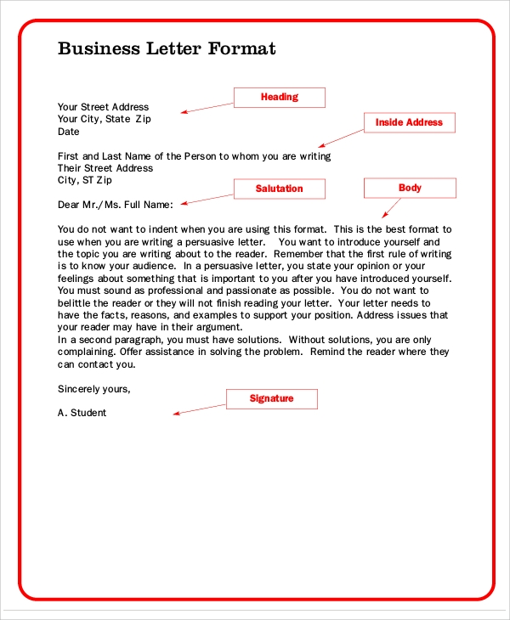
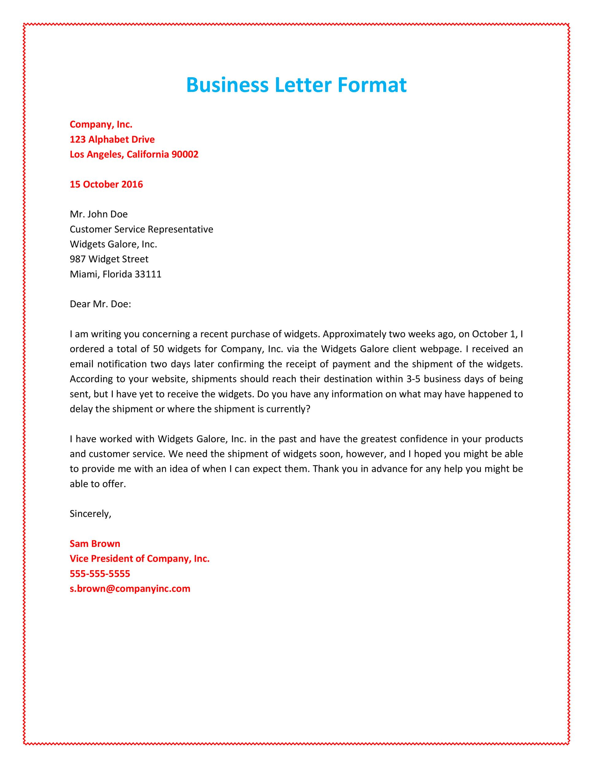

Slide 31


